Slide 1
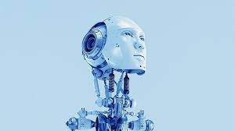
Thoughts about Artificial Intelligence
HealthTechNet
July 21, 2023
Jim Oakes

Slide 2
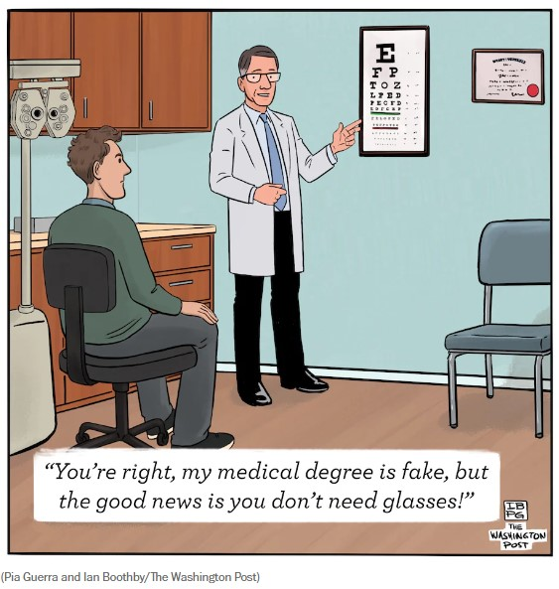

Slide 3
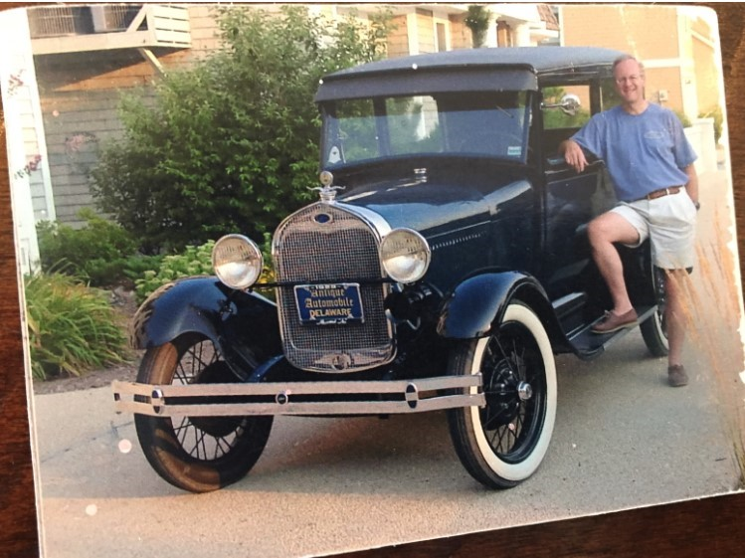

Slide 4
What Are We Talking About Anyway?
Advanced Analytics?
Predictive AI?
Generative AI?
Machine Learning?
Other?

Slide 5
Many AI-like Applications have been around for years, and more are coming..
APACHE
Alexa
Speech Recognition applications
ChatBots
PathAI
BERG
BenevolentAI
Kheiron Medical
And many more..

Slide 6
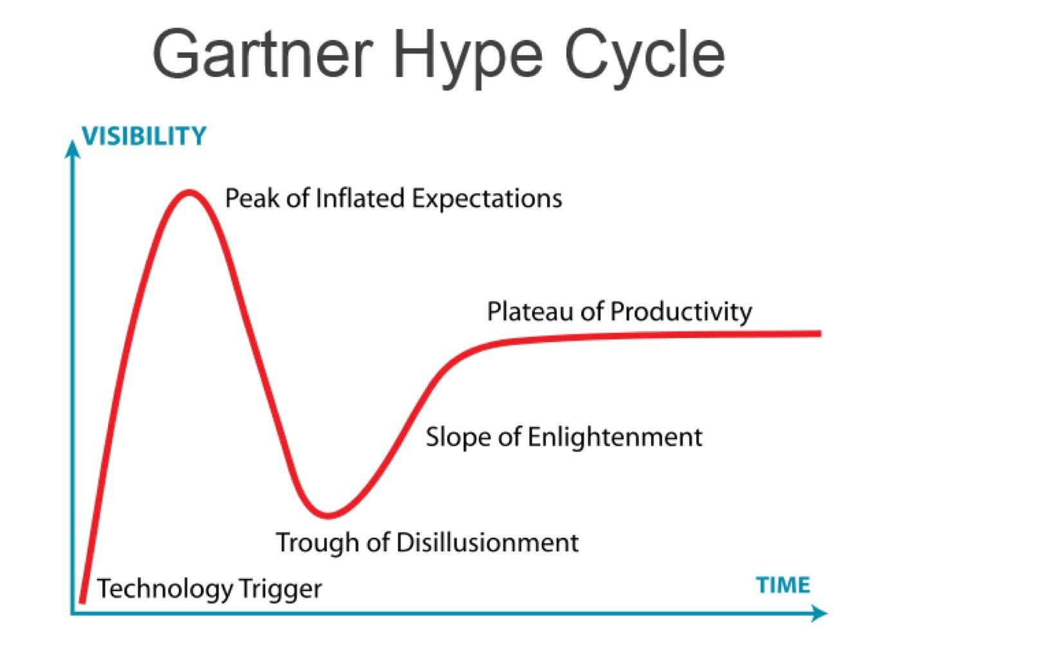

Slide 7
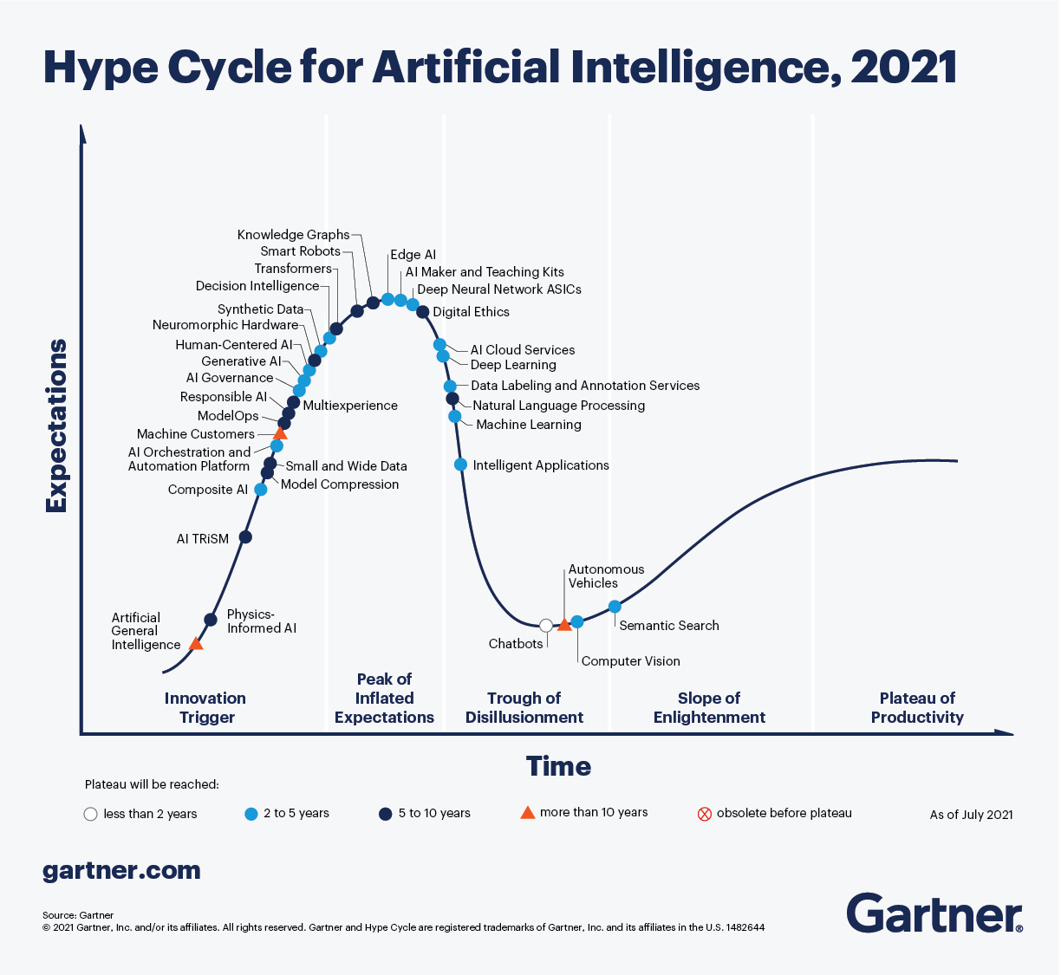

Slide 8
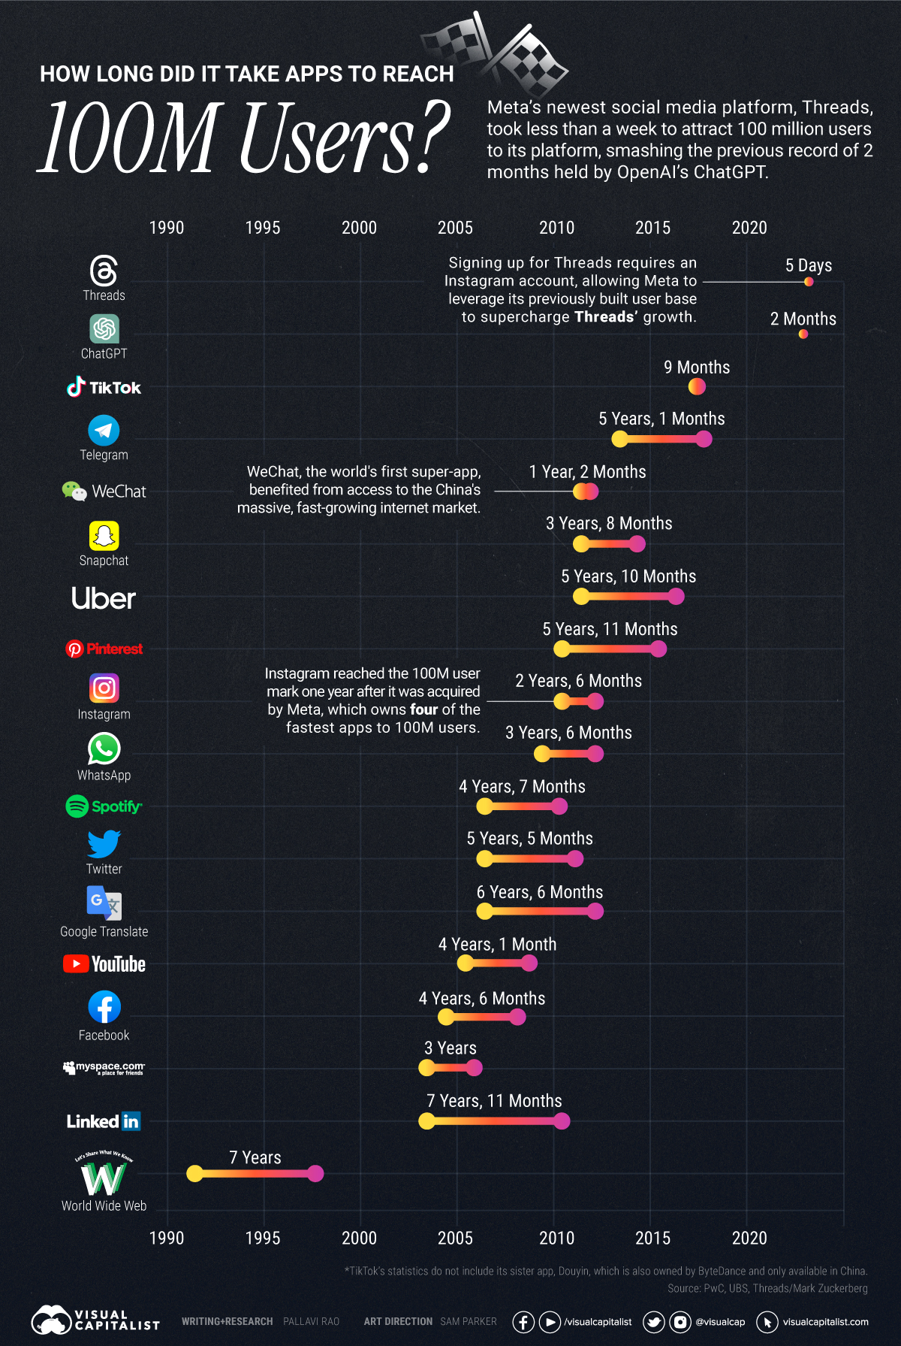

Slide 9
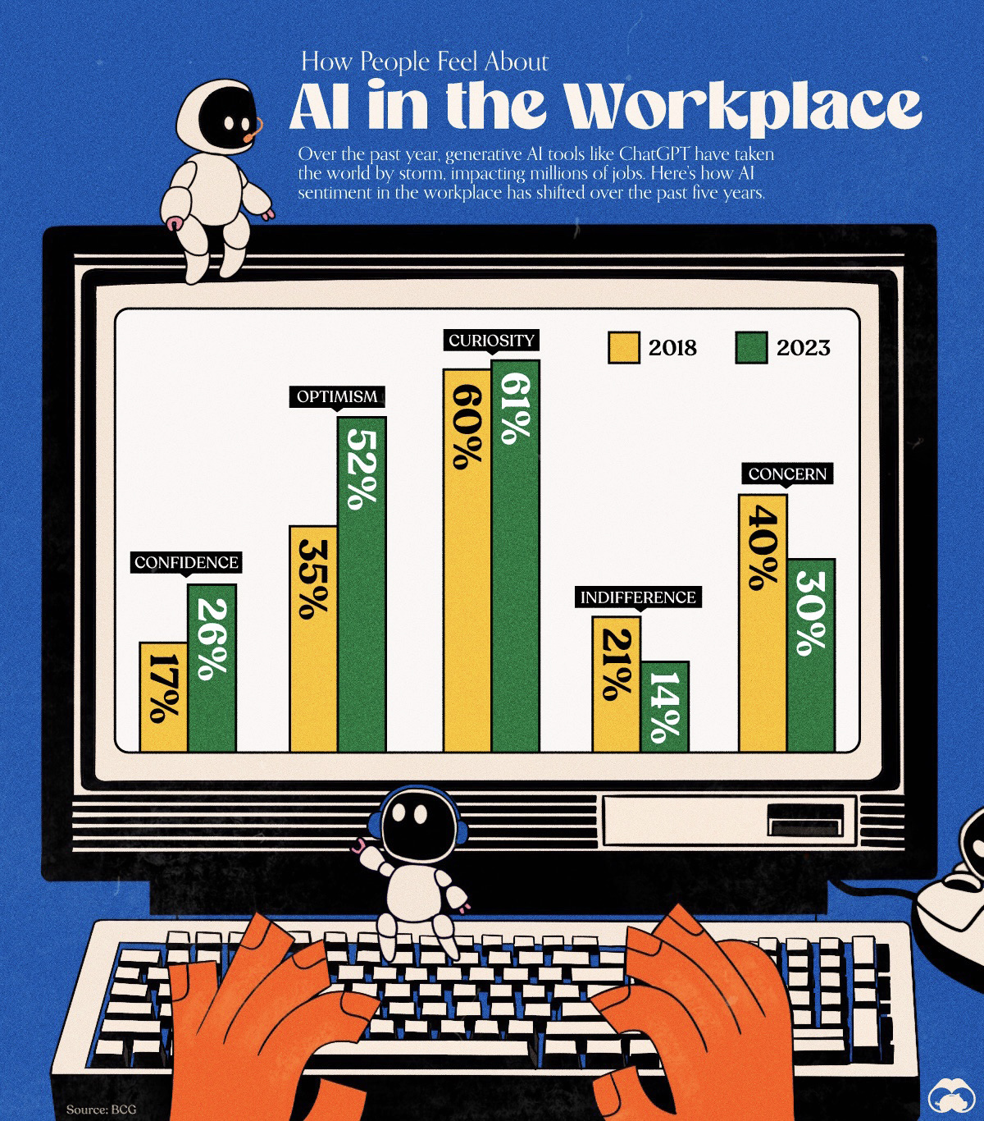

Slide 10
Gartner Group Predictions….
By 2025, 30% of marketing content will be created by generative AI but human-augmented, up from less than 2% in 2022.
More than 50% of advanced virtual assistants (VAs) will be industry-domain-specific, up from less than 25% in 2022.
By 2025, AI avatars leveraging text-to-video using generative AI technology will support 70% of digital and marketing communications from less than 2% in 2022.
Source: The Gartner Group

Slide 11
Opinion
The AI revolution in health care is already here
FTC investigates OpenAI over data leak and ChatGPT’s inaccuracy
The agency’s demand for OpenAI’s documents marks the company’s greatest U.S. regulatory threat to date

